Slide 1
Bioinformatics Workshop #1
Hwang Lab, QHS
1/19/2018

Slide 2
Announcement
Anybody did not bring a CCF-certified laptop?
Dr. Hwang lab
Changjin, Yunku, and Jean
Restroom location
9 to 5 PM (Lunch: noon to 1 PM)
1 hour PPT slides
Rest of the hours: Exercise in Linux servers

Slide 3
Agenda
9 to 9:20: Setup connection
9:20 to 10:30 Introduction to Bioinformatics
10:40 to 11:20 Linux Basics
11:25 to 12 Bash Shell Scripts
Lunch
1 to 1:50 QC FASTQ files
2 to 2:25 : Alignments
2:30 to 3:00 : Post processing alignments
3:05 to 3:35 : GATK variant calls
3:45 to 4:30 : VCF and annotation
4:40 to 5:00 : Question/Answer

Slide 4
Welcome and Setup
Survey the computational skill
Form a group with two
Anybody does not bring a CCF-certified laptop?
Connect to CCF network
Assigning Linux server IP address to each of you

Slide 5
Introduction to Bioinformatics
Big data era
Successful NGS applications
Experiment design
Overall Bioinformatics pipeline structure
Next-generation sequencing technology (Jean)
Illumina
Nanopore
Alignment (Yunku)
BWA-mem
HISAT
NCBI BLAST (demo)

Slide 6

What is Bioinformatics?
Handling massive heterogeneous biological data
What is Bioinformatics?
Application of techniques from computer science, statistics, mathematics, and engineering to problems from biology
Interdisciplinary
Genomics
Proteomics
Metabolomics
Metagenomics
and etc.

Slide 7
Human genome project
Human genome project (start date: 1990 ~ complete date: Feb. 2001)
Goal: Sequence and identify ~ 3 billions base pairs in the human genome. Ultimately find the genetic roots of disease and develop treatments
10 years and 3 billion dollars

Slide 8
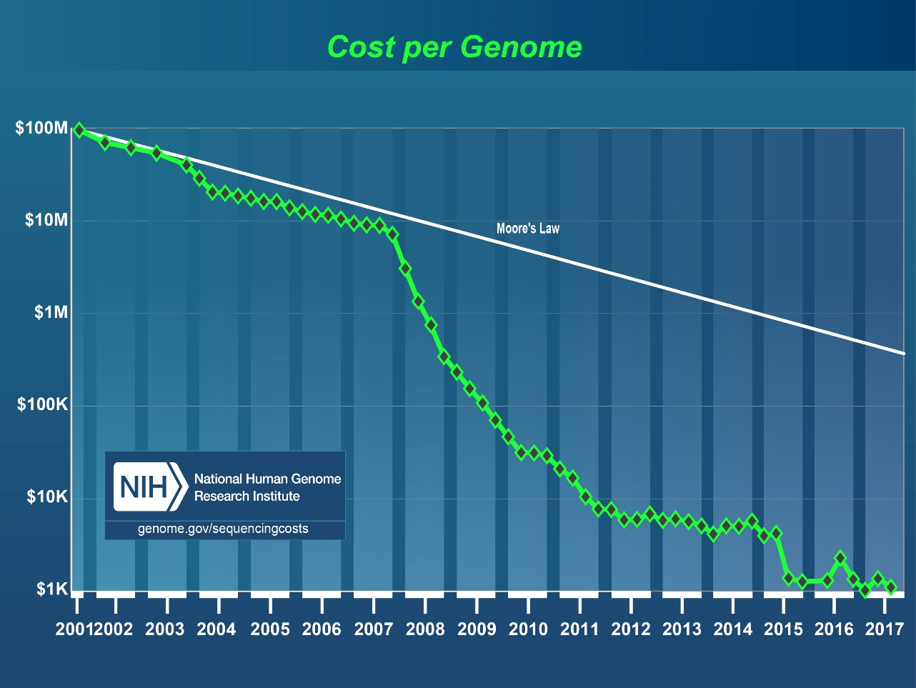
Cost per genome
Cost per genome has been significantly dropped

Slide 9
Biological data
Slide from Michael Schatz

Slide 10
How much is a Petabyte?
Name | Name in Byte | Number of Zeros | Groups of 3 Zeros | Example
One | Byte
Thousand | Kilobyte | 3 | 1 | 10 KB word doc file
Million | Megabyte | 6 | 2 | 3.4 MB mp3 song
Billion | Gigabyte | 9 | 3 | 4.7 GB DVD
Trillion | Terabyte | 12 | 4 | 4.0 TB external hard drive
Quadrillion | Petabyte | 15 | 5 | 10K human genomes
Quintillion | Exabyte | 18 | 6 | ?
Sextillion | Zettabyte | 21 | 7 | 10B human genomes
Notes:
https://www.thoughtco.com/zeros-in-million-billion-trillion-2312346

Slide 11
How much is a Petabyte?
Slide from Michael Schatz

Slide 12
DNA Data Tsunami (~2018)
Slide from Michael Schatz

Slide 13
DNA Data Tsunami (future)
Slide from Michael Schatz

Slide 14
Application
DNA sequencing helped to save Nicholas Volker
Notes:
6 year old Nicholas was struggled from dangerously inflamed intestine since he was toddler. He went through a hundred surgeries and they removed his colon.
There was no clue or any conventional clinical trials were not successful. Finally, scientists ended up sequencing his DNA.

Slide 15
Application
A bone marrow transplant of cells taken from umbilical chord blood
Notes:
Interestingly, they sequenced all his genes and discovered a mutation that caused his disease and leading to his immune system defective.
In October, 2010, they purged the defective immune system and performed bone marrow transplant from the donor placenta and umbilical cord blood cell. Then, his immune system started to work properly and he was saved.

Slide 16
Application
“Finding a needle in a haystack”
The Wisconsin scientists who decoded Nicholas' DNA are writing up the case for a medical journal. In late March, David Dimmock, a Children's Hospital genetics specialist, described the work at a meeting of the American College of Medical Genetics in Albuquerque, N.M. Dimmock explained the extensive search that took scientists from a list of more than 16,000 variations - departures from the normal genetic sequence - to the single one responsible for the boy's illness.
Notes:
Finding a needle in the stack

Slide 17
Application
Joshua brain had been swelling with fluid
Notes:
In 2014, 14-year-old Joshua was admitted due to his swelling brain with fluid. A battery of tests all failed to figure out the cause (encephalitis). Parents and doctors decided to run a test with experimental new technology.

Slide 18
Application
Identified root of illness in 2 days + 96 min
Notes:
Dr. Gern’s team received serum from Joshua’s cerebrospinal fluid for testing. They started to sequence his DNA material and completed in 2 days. In 96 min of computational work, they discovered that Joshua’s cerebrospinal fluid contained DNA from Leptospira which is potentially lethal type of bacteria. After the treatment of penicillin, he was successfully recovered!

Slide 19
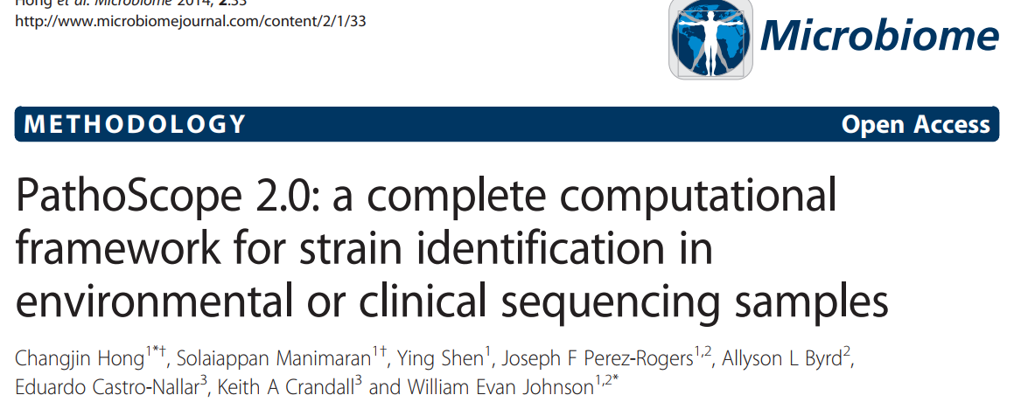
Application
Another exciting story

Slide 20
Application
Optimal dosing of a drug for patients
Notes:
Polymorphism in Cytochrome (an enzyme expressed in liver) vs. tricyclics efficacy

Slide 21
Application
Who am I? Privacy

Slide 22
Application
See human as a body/soul vs. DNA sequence

Slide 23
Experimental design
What are my goals?
SNPs, Indels, and Structural Variations
DNA-Seq (Targeted, Whole exome, or Whole genome sequencing)
Transcriptome assembly (RNA-Seq)
Differential expressed genes (RNA-Seq)
Identify rare transcripts (RNA-Seq)
What are the characteristics of the organism to study?
Large, complex genome
Introns and high-degree of alternative splicing
no reference genome or transcriptome

Slide 24
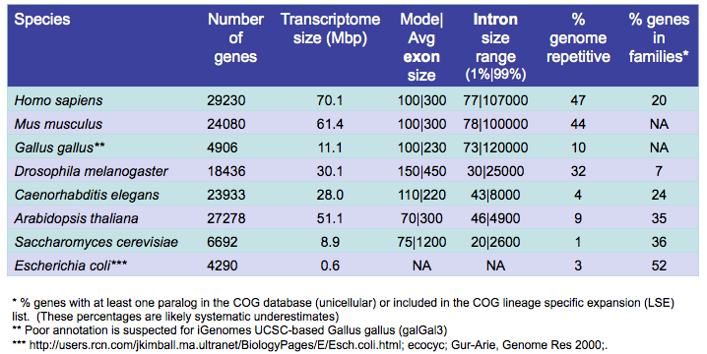
Experimental design

Slide 25
Sequencing Depth vs. Cost
Items | Values | Cost
# of flowcell | 2 (Dual flow cell)
Reads Passing Filter in HiSeq 2500 | 600 million | $2,000 Rapid run mode (SBS Kit v2, a sequencing reagent) covering 16 samples
Read length | 2x100 bp
Undetermined index rate | 0.05
Region covered by Agilent SureSelect V6 kit | 60Mb | $4,779
FASTQ to BAM conversion rate (after dedup/removing off-target reads) | 0.75
# of samples to load/flowcell | 8
Expected sequencing depth | 90x = 600M*200bp*(1-0.05)*0.75/(2*8*60M)

Slide 26
Experimental design
Technical replicates
Identical sample but any variation in both wet lab and dry lab protocols
Not needed: low technical variation
Minimize batch effects/Randomize sample orders
GIAB as a reference material in clinical settings
Biological replicates
Not needed for transcriptome assembly
Essential for differentially expressed genes discovery
Difficult to estimate, but …we recommend
3+ for cell lines, 5+ for inbred lines, 20+ human samples

Slide 27
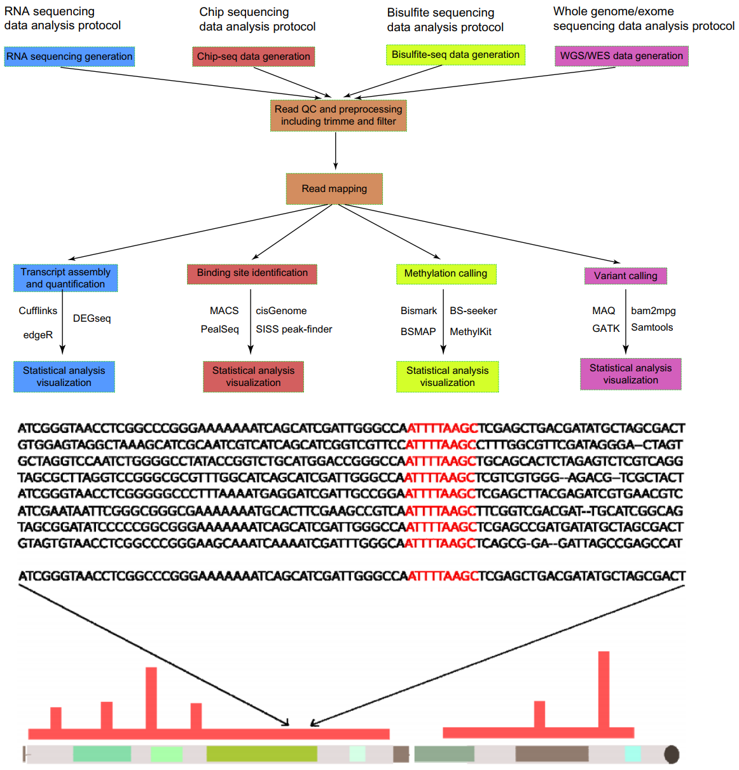
annotation

Slide 28
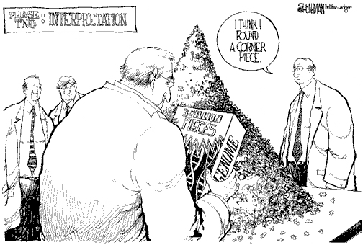
Bioinformatics role
To reduce both cost and time to narrow down a potential hypothesis
vs. To discover a significant signal from heterogeneous massive data in mathematical model or statistical analysis
Connecting dots among routine analysis modules
Implementation: Data process and visualization (Java, C++, Perl, Python, R …)

Slide 29
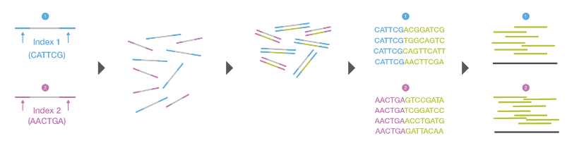
NGS technology
Next Generation Sequencing (NGS):
High Throughput (Tbp per run)
High Fidelity
RNA seq
Illumina, Roche 454, SOLiD, etc.
New Technologies: Nanopore
https://www.illumina.com/content/dam/illumine-marketing/documents/products/illumina_sequencing_introduction.pdf

Slide 30
Illumina Sequencing
DNA Fragments (200-600bp) sequenced
Fluorescently-labeled dNTPs
Parallelization of reads across millions of fragments
Alignment of reads is required after sequencing.
Paired-End Sequencing
Reverse strand is also read
Notes:
Paired-End: Both ends are read, reduce ambiguity, detect indels.

Slide 31
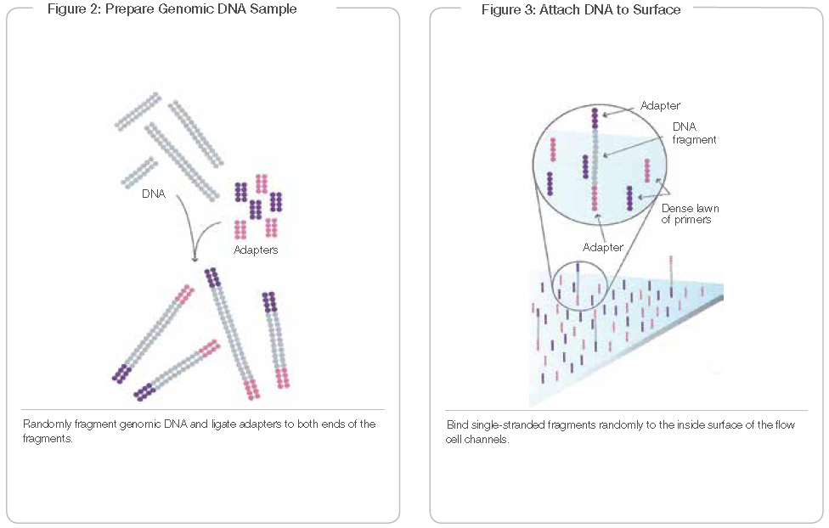
Illumina Sequencing
https://www.illumina.com/documents/products/techspotlights/techspotlight_sequencing.pdf
Notes:
DNA is fragmented and tagged
DNA is fixed to substrate

Slide 32
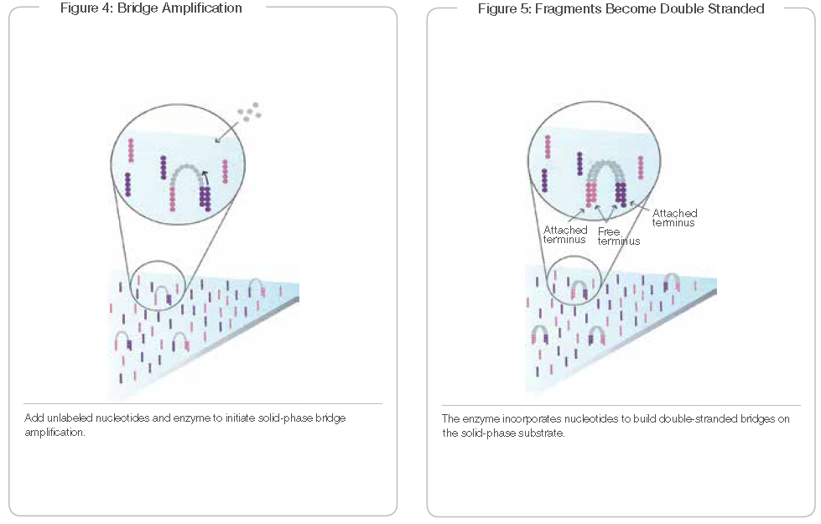
Illumina Sequencing
https://www.illumina.com/documents/products/techspotlights/techspotlight_sequencing.pdf
Notes:
Formation of clusters by amplification

Slide 33
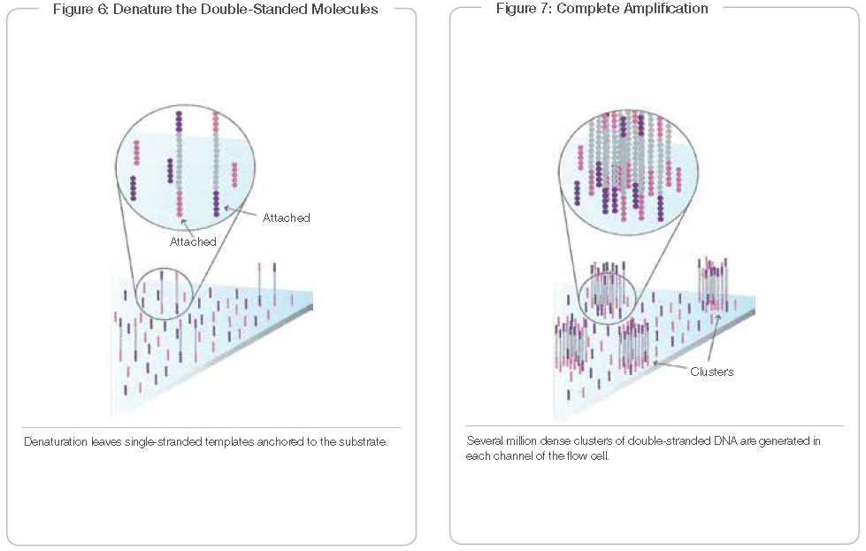
Illumina Sequencing
https://www.illumina.com/documents/products/techspotlights/techspotlight_sequencing.pdf

Slide 34
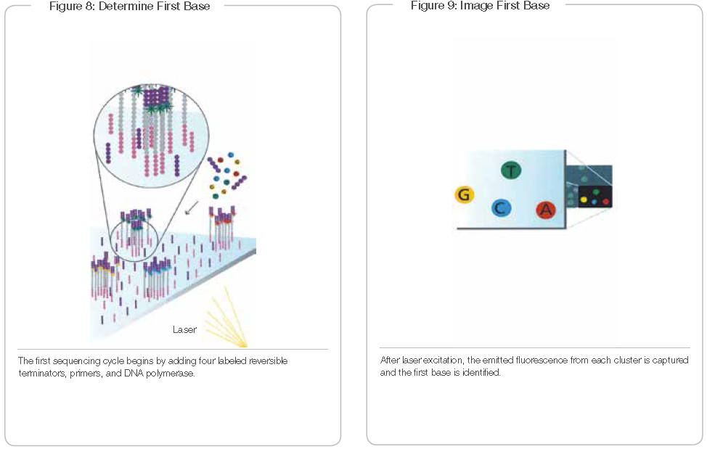
Illumina Sequencing
https://www.illumina.com/documents/products/techspotlights/techspotlight_sequencing.pdf
Notes:
Fluorsecent dNTPs are added and read by laser. F-dNTP is then removed

Slide 35
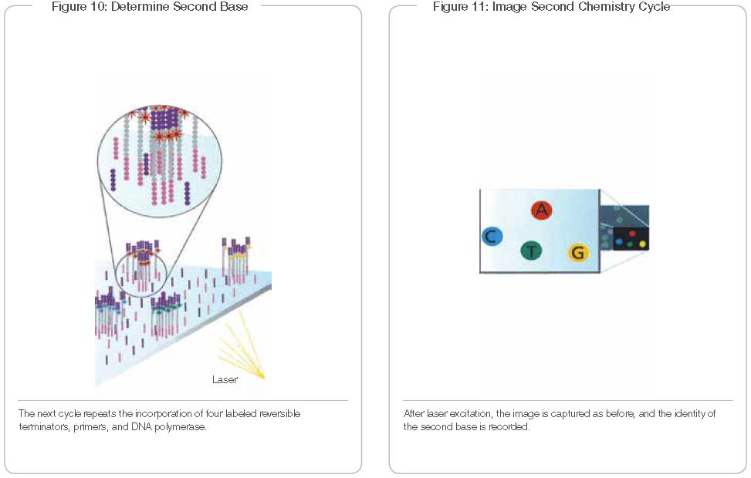
Illumina Sequencing
https://www.illumina.com/documents/products/techspotlights/techspotlight_sequencing.pdf

Slide 36
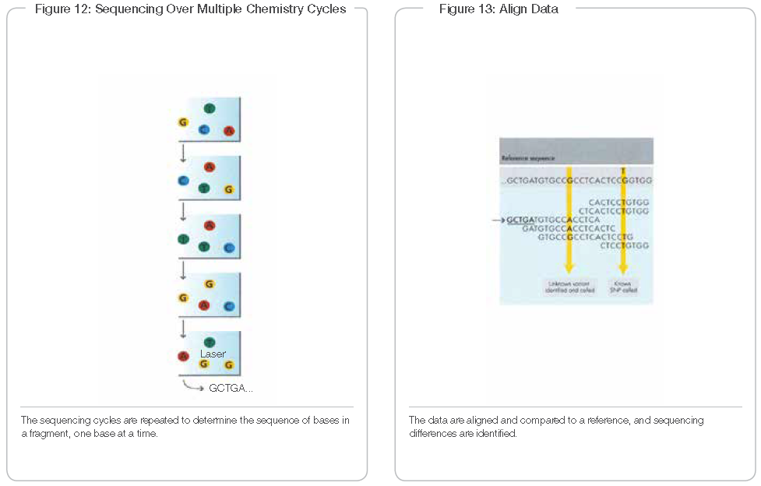
Illumina Sequencing
https://www.illumina.com/documents/products/techspotlights/techspotlight_sequencing.pdf

Slide 37
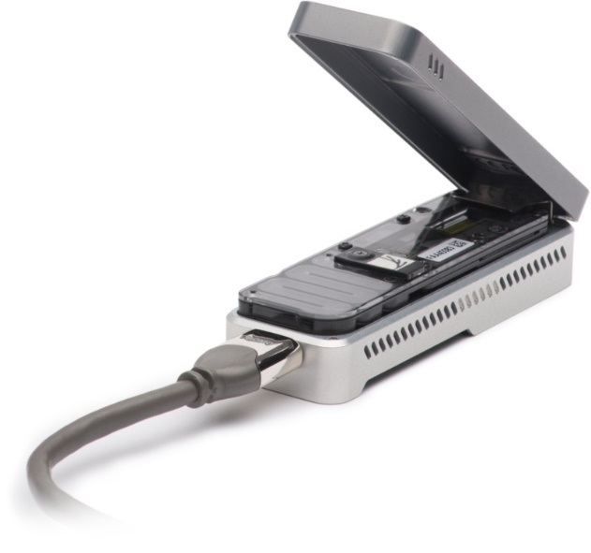
Nanopore Sequencing
Real-Time sequencing
Long reads (100kbp+)
Detect gene fusions
Simple sample prep
Tag DNA fragments with beads
Ligate DNA fragments to helper proteins
Load sample into flowcell
Run
Accuracy is highly dependent on algorithm.
Notes:
Molecule passes through protein nanopore across a conductive membrane.
Changes in current produce signal that correlates to Nucleotide bases.

Slide 38
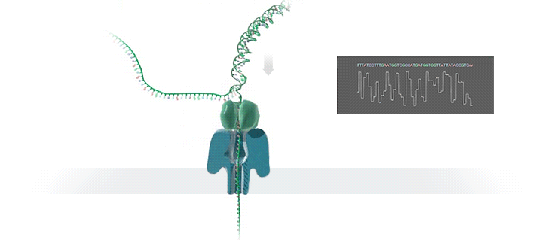
Nanopore Sequencing
https://nanoporetech.com/how-it-works

Slide 39
Alignments
Yunku Yeu, Ph.D

Slide 40
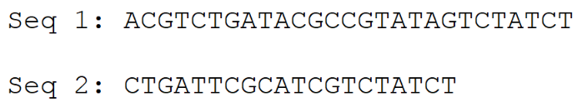
What is alignment?
How to compare these two sequences?
A possible alignment
ACGTCTGATACGCCGTATAGTCTATCT ||||| ||| || |||||||| ----CTGATTCGC---ATCGTCTATCT
Matches: 18 × (+1)
Mismatches: 2 × 0
Gaps: 7 × (– 1)
Score = +11
Alignment: a method for arranging of sequences to identify similar regions

Slide 41
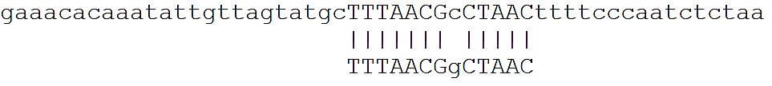
Overview of Sequence alignment
Global vs. local alignment
Global alignment : alignment from end to end
Local alignment: better alignment to find conserved segment
Short read alignment

Slide 42

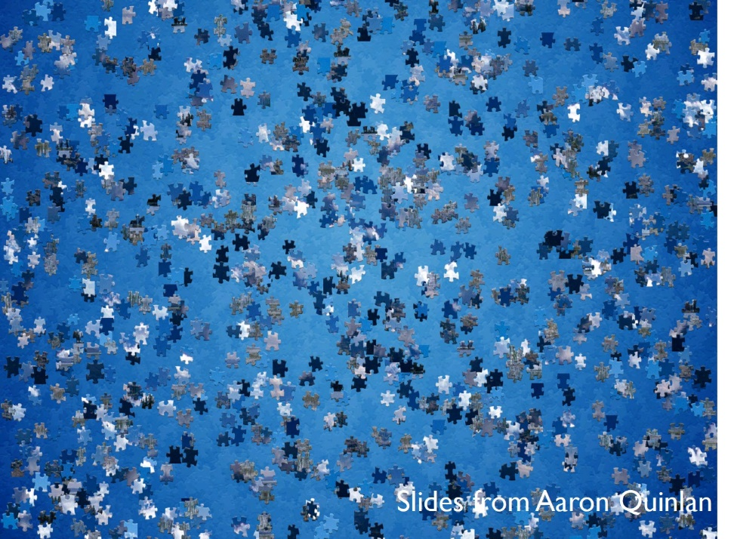
Overview of Sequence alignment
Short read alignment
Short read alignment: A jigsaw puzzle
- Pieces are compared to the original image
+ The pieces may be slightly different to the original image

Slide 43
Overview of Sequence alignment
Reference genome
Specially designed algorithm is required.
We will cover BLAT, BWA, HISAT2

Slide 44
Short read alignment: two steps
Most of alignment algorithms consist of two steps: Indexing and Alignment
Indexing
Organization of the reference genome to make it easier to find subsequence
Alignment
Exploiting the index, find matches between query and reference sequences

Slide 45
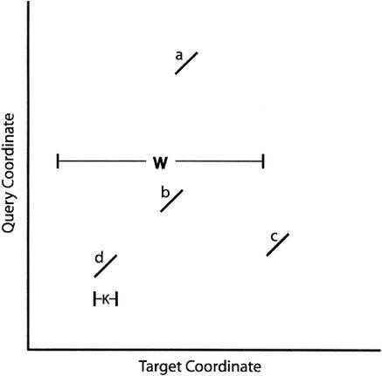
BLAT
BLAT (Blast-Like Alignment Tool)
Record (Index) all occurrences of the k-mers in the reference sequence. (default is 11 for DNA, and 5 for protein)
Divide the query sequence into k-mers, then search the matched k-mers in the reference, using the index
Find multiple (nearly) perfect matches and connect them

Slide 46
BLAT
BLAT vs. BLAST
 | BLAT | BLAST
Algorithmic difference | Index database, Search query (one genome) | Index query, Search database (multiple genomes)
Speed | Fast | Slow
Accuracy | Less sensitive | More sensitive
But BLAT is still very sensitive

Slide 47
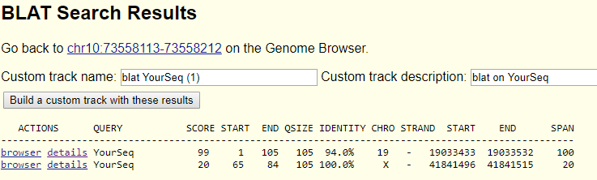
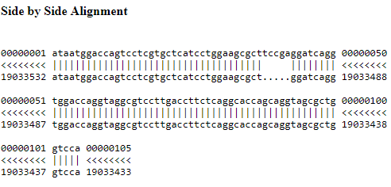
BLAT
Interpretation of BLAT alignment
http://genome.ucsc.edu/cgi-bin/hgBlat
(2)
(1)
Insertion
Query
Reference

Slide 48
BWA
Still, Exist techniques including BLAT are too slow and not applicable for large short read data
Burrows-Wheeler Transform
Reference: unabasbable
Suffice
Sorted suffice
0 unabasbable$
1 nabasbable$u
2 abasbable$un
3 basbable$una
4 asbable$unab
5 sbable$unaba
6 bable$unabas
7 able$unabasb
8 ble$unabasba
9 le$unabasbab
10 e$unabasbabl
11 $unabasbable
0 11 $unabasbable
1 2 abasbable$un
2 7 able$unabasb
3 4 asbable$unab
4 6 bable$unabas
5 3 basbable$una
6 8 ble$unabasba
7 10 e$unabasbabl
8 9 le$unabasbab
9 1 nabasbable$u
10 5 sbable$unaba
11 0 unabasbable$
Much Faster, memory-efficient
One of most popular DNA short read alignment tools
Sorting
(11,2,7,4,6,3,8,10,9,1,5,0)
enbbsaalbua$
Suffix array
BWT string
https://www.cs.cmu.edu/~ckingsf/bioinfo-lectures/bwt.pdf

Slide 49
BWA
The LF property allows fast extending of the alignment
LF Property: The i^{th} occurrence of a letter X in the last column corresponds to the i^{th} occurrence of X in the first column
Burrows-Wheeler Transform
Reference: unabasbable
Suffice
Sorted suffice
0 unabasbable$
1 nabasbable$u
2 abasbable$un
3 basbable$una
4 asbable$unab
5 sbable$unaba
6 bable$unabas
7 able$unabasb
8 ble$unabasba
9 le$unabasbab
10 e$unabasbabl
11 $unabasbable
0 11 $unabasbable
1 2 abasbable$un
2 7 able$unabasb
3 4 asbable$unab
4 6 bable$unabas
5 3 basbable$una
6 8 ble$unabasba
7 10 e$unabasbabl
8 9 le$unabasbab
9 1 nabasbable$u
10 5 sbable$unaba
11 0 unabasbable$
Query: aba
1) Start from the last character ‘a’
2) Find range of the ‘a’ in the first column: [1-3]
3) Check next character, ‘b’ at the last column: [2-3]
4) The ‘b’s are 1st & 2nd ‘b’ at the last column → They correspond to the 1st & 2nd ‘b’ at the first column [4-5]
5) Check next character ‘a’ at the last column: [5]
Finished.
Sorting
(11,2,7,4,6,3,8,10,9,1,5,0)
enbbsaalbua$
Suffix array
BWT string

Slide 50

RNA-seq alignment
Difficulties in RNA-seq alignment: Splice junction
A read may be split into two exons.
Distance between the exon (=size of intron) could be very long
Tools for RNA-seq alignment
Tophat2, STAR, and HISAT2
HISAT uses Hierarchical BWT indices – Global and local
Global index find possible mapping positions over the genome
For the possible mapping positions, very small local index is used to identify splice sites.
Small local index → smaller search space → extensive search

Slide 51
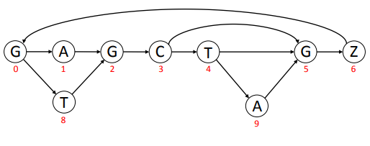
HISAT2
HISAT2 uses graph theory in order to incorporate SNPs
Common SNPs were incorporated. If a mismatch occurs on the common SNPs, there is no penalty for the alignment.
They incorporates 12.3M SNPs and indexes all possible alignment using graph
HISAT2 is the most accurate short read aligner for RNA-seq data (S. Sahraeian et al, Nature com. 8:59, 2017)
Compared with Tophat2 and STAR
DEL
Original Ref: GAGCTG
Common SNP
INS
https://ccb.jhu.edu/software/hisat2/data/HISAT2-first_release-Sept_8_2015.pdf

Slide 52
3rd-gen. sequencing
Recent technological advance allows generating of sequence reads that are > 1kb ~ 1Mb
Nanopore, PacBio
Due to its longer length and higher error rate, specially designed tools should be used
LAST, minimap2, …
Longer sequence read may solve many problems
Isoform identification
Gene fusion detection
Structural variation identification

Slide 53
FASTQ and Quality Assessment

Slide 54
Sample preparation
Sample preparation
(paired-end sequencing data)
CASAVA:Illumina software package for base calling
Fastq format
Text format. Stores sequence and quality info
4 lines per seuqences
CASAVA 1.8 header line:
Lane
Tile
Run ID
QC Filter flag:
Y=bad, N=Good
X& Ycoordinate
Instrument
Read pair #
Barcode
@HWI-ST1073:280:D18HTACXX:2:1101:2579:1928 1:N:0:CGATGT
NGGGATGTTGTTTCTCGAAGTGGCAAGCATTTTTTAGTAATATTTTGACTTTTTAATACCTTTCTTTGCATATGGAGCAGAAAACAGTGACACTGGATAT
+
#1:DADBDD<ADDCEEE3A1ABFBEF?;)*9CD9::B*9DEEAD>DDDEDEEEIIIECAACEEIEII:@AD?;CC>?;;@(.6(;>?AAAAAAAA?A>AA
Phred-quality scores

Slide 55
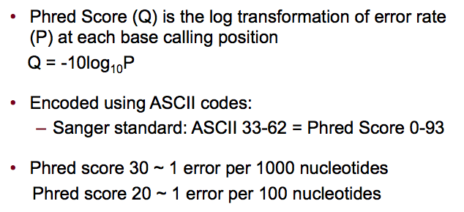
Phred quality score
@HWI-ST1073:280:D18HTACXX:2:1101:2579:1928 1:N:0:CGATGT
NGGGATGTTGTTTCTCGAAGTGGCAAGCATTTTTTAGTAATATTTTGACTTTTTAATACCTTTCTTTGCATATGGAGCAGAAAACAGTGACACTGGATAT
+
#1:DADBDD<ADDCEEE3A1ABFBEF?;)*9CD9::B*9DEEAD>DDDEDEEEIIIECAACEEIEII:@AD?;CC>?;;@(.6(;>?AAAAAAAA?A>AA
Phred-quality scores
Ex) If error rate is equal to 0.001, then Phred quality score is 30
30 = -10log10(0.001)
(error rate 0.001)
(error rate 0.01)

Slide 56
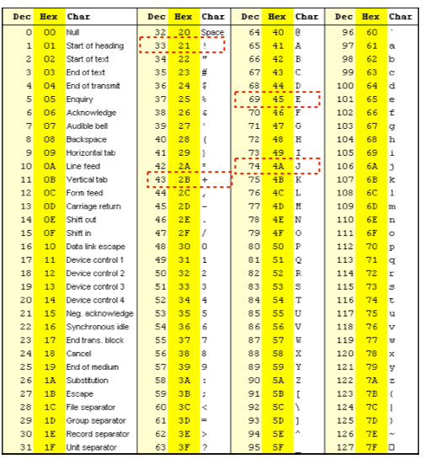
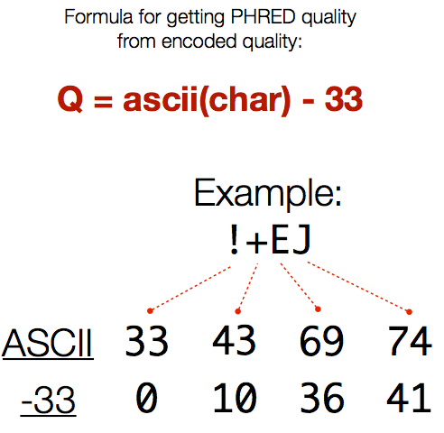
Phred quality score
@HWI-ST1073:280:D18HTACXX:2:1101:2579:1928 1:N:0:CGATGT
NGGGATGTTGTTTCTCGAAGTGGCAAGCATTTTTTAGTAATATTTTGACTTTTTAATACCTTTCTTTGCATATGGAGCAGAAAACAGTGACACTGGATAT
+
#1:DADBDD<ADDCEEE3A1ABFBEF?;)*9CD9::B*9DEEAD>DDDEDEEEIIIECAACEEIEII:@AD?;CC>?;;@(.6(;>?AAAAAAAA?A>AA
Phred-quality scores
Slides from Aaron Quinlan

Slide 57
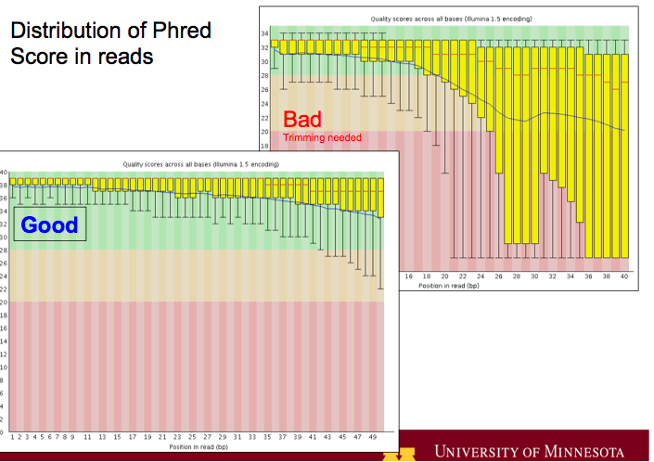
Poor quality of library
Poor quality read library decreases mapping performance
Phred 30 = 1 error / 1000 bases
Phred 20 = 1 error / 100 bases

Slide 58
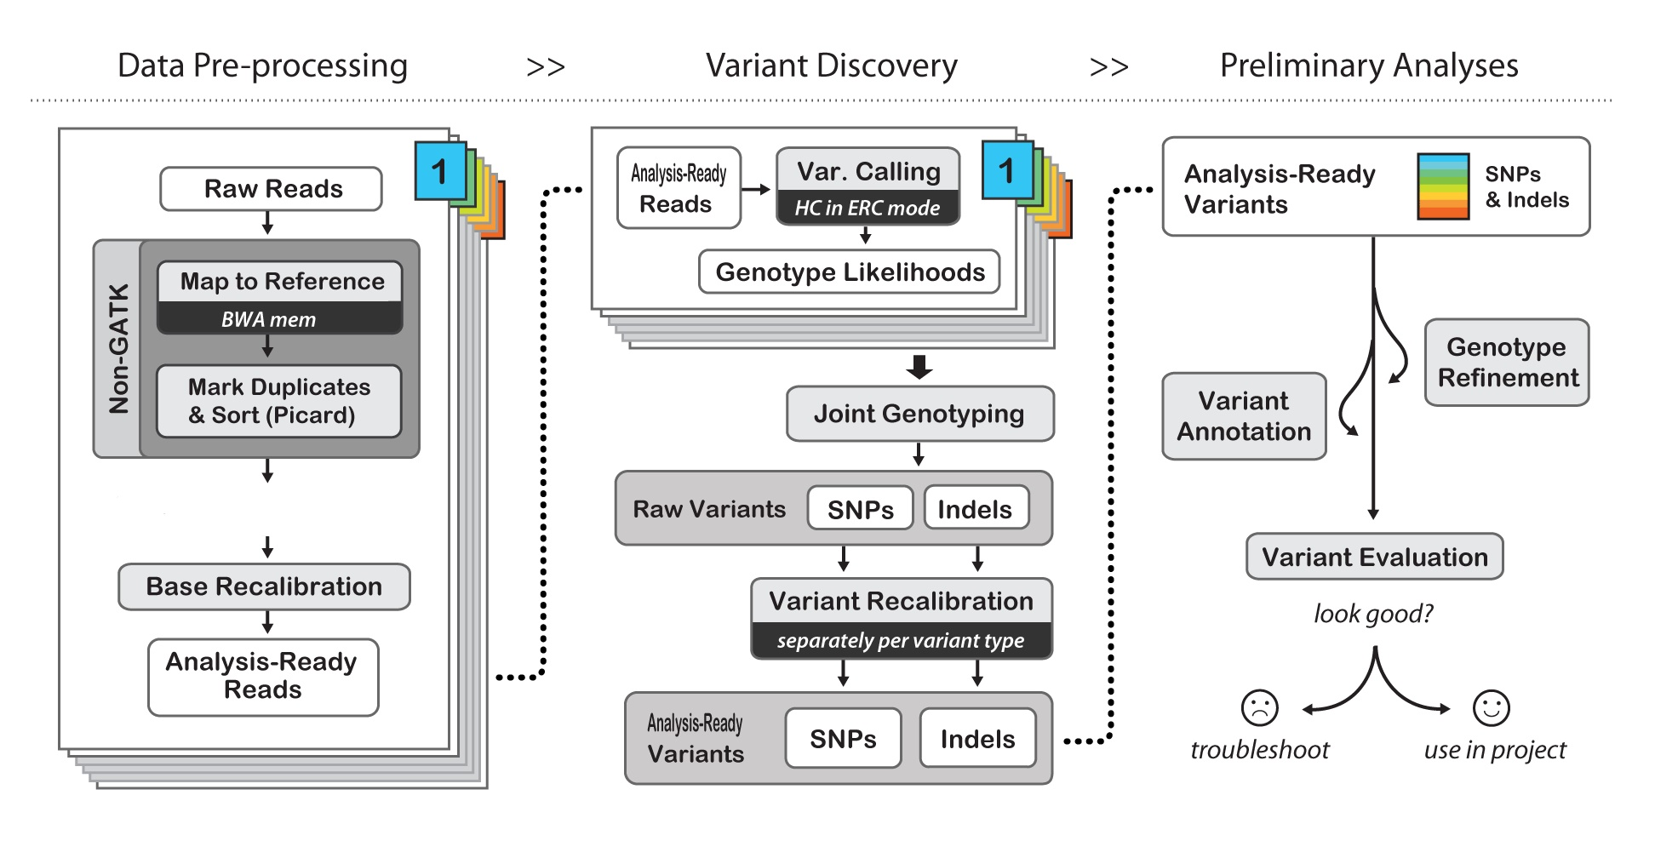
GATK and VCF

Slide 59
Acknowledgement
Michael Weiner, A Unix Administrator
Technical support team
Staffs reserved this auditorium
All of you attended this workshop!

